Slide 1

Selection Sort
Dr. Ashish Sharma
Dept. of CEA, GLA University, Mathura

Slide 2
Selection Sort
0 1 2 3 4
64 25 12 22 11
N=5
i=0,1,2,3
Take i=0, min_indx=0;
J=1,2,3,4
Take J=1 , a[1]<a[0] 25<64 yes min_indx=1
J=2, a[2]<a[1] 12<25 yes min_indx=2
J=3, a[3]<a[2] 22<12 No
J=4 a[4]<a[2] 11<12 yes min_indx=4
Now swap the 0th element 64 with minimum element found at 4th index a[0] a[4]
11 25 12 22 64

Slide 3
Selection Sort
0 1 2 3 4
11 25 12 22 64
Take i=1, min_indx=1;
J=2,3,4
Take J=2 , a[2]<a[1] 12<25 yes min_indx=2
J=3, a[3]<a[2] 22<12 NO
J=4, a[4]<a[2] 64<12 NO
Now swap the 1st index element 25 with min. element at 2nd index a[1] a[2]
11 12 25 22 64

Slide 4
Selection Sort
0 1 2 3 4
11 12 25 22 64
Take i=2, min_indx=2;
J=3,4
Take J=3 , a[3]<a[2] 22<25 yes min_indx=3
J=4, a[4]<a[3] 64<22 NO
Now swap the 2nd index element 25 with min. element at 3rd index a[2] a[3]
11 12 22 25 64

Slide 5
Selection Sort
0 1 2 3 4
11 12 22 25 64
Take i=3, min_indx=3;
J=4
Take J=4 , a[4]<a[3] 64<25 No
Now swap required: Sorted Array
11 12 22 25 64

Slide 6
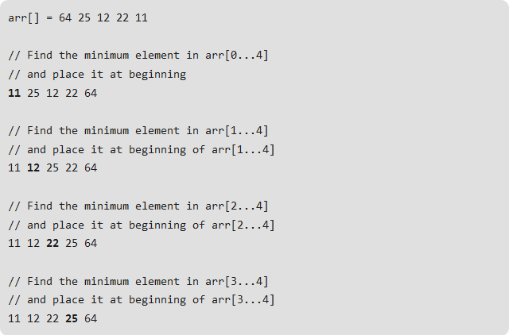
Selection Sort

Slide 7
contd..
void selectionSort(int arr[], int n)
{
int i, j, min_idx;
for (i = 0; i < n-1; i++)
{
min_idx = i;
for (j = i+1; j < n; j++)
if (arr[j] < arr[min_idx])
min_idx = j;
// Swap the found minimum element with the first element
swap(&arr[min_idx], &arr[i]);
}
}

Slide 8
contd..
void swap(int *xp, int *yp)
{
int temp = *xp;
*xp = *yp;
*yp = temp;
}

Slide 9
contd..
void printArray(int arr[], int size)
{
int i;
for (i=0; i < size; i++)
printf("%d ", arr[i]);
}
int main()
{
int arr[] = {64, 25, 12, 22, 11};
int n = sizeof(arr)/sizeof(arr[0]);
selectionSort(arr, n);
printf("Sorted array: \n");
printArray(arr, n);
return 0;
}

Slide 10
Thank You

Slide 11
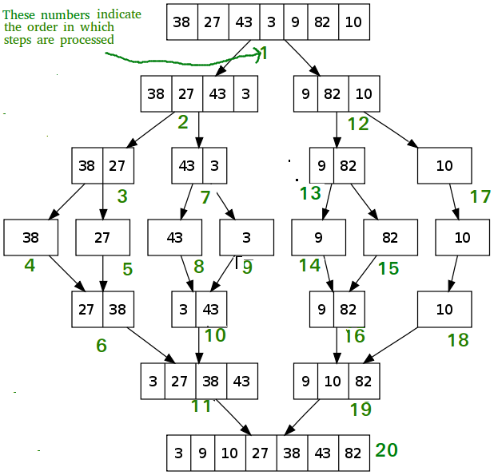
Merge Sort

Slide 12
contd..
void mergeSort(int arr[], int l, int r)
{
if (l < r)
{
// Same as (l+r)/2, but avoids overflow for
// large l and h
int m = l+(r-l)/2;
// Sort first and second halves
mergeSort(arr, l, m);
mergeSort(arr, m+1, r);
merge(arr, l, m, r);
}
}

Slide 13
contd..
// Merges two subarrays of arr[].
// First subarray is arr[l..m]
// Second subarray is arr[m+1..r]
void merge(int arr[], int l, int m, int r)
{
int i, j, k;
int n1 = m - l + 1;
int n2 = r - m;
/* create temp arrays */
int L[n1], R[n2];
/* Copy data to temp arrays L[] and R[] */
for (i = 0; i < n1; i++)
L[i] = arr[l + i];
for (j = 0; j < n2; j++)
R[j] = arr[m + 1+ j];

Slide 14
contd..
/* Merge the temp arrays back into arr[l..r]*/
i = 0; // Initial index of first subarray
j = 0; // Initial index of second subarray
k = l; // Initial index of merged subarray
while (i < n1 && j < n2)
{
if (L[i] <= R[j]) {
arr[k] = L[i];
i++; }
else{
arr[k] = R[j];
j++; }
k++;
}

Slide 15
contd..
/* Copy the remaining elements of L[], if there are any */
while (i < n1)
{
arr[k] = L[i];
i++;
k++;
}
/* Copy the remaining elements of R[], if there are any */
while (j < n2)
{
arr[k] = R[j];
j++;
k++;
}
}

Slide 16
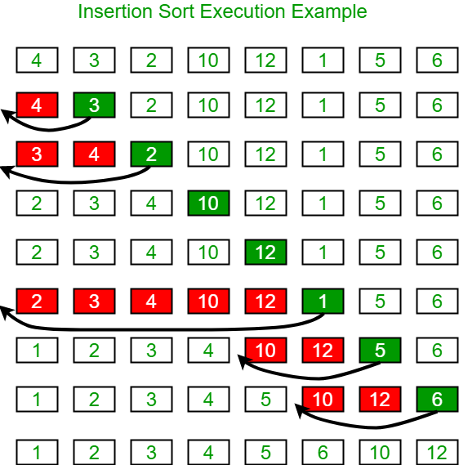
2. Insertion Sort

Slide 17
contd..
0 1 2 3 4 5 6 7
4 3 2 10 12 1 5 6
N=8
i=1,2,3,4,5,6,7
Take i=1
Key=a[i]=a[1]=3
J=i-1=1-1=0
Loop : j>=0 and a[j]>key i.e. a[0]>3 4>3 yes
A[j+1]=a[j] a[1]=a[0]
4 4 2 10 12 1 5 6
j=j-1=-1 loop will be false
After loop a[-1+1]=3
3 4 2 10 12 1 5 6

Slide 18
contd..
0 1 2 3 4 5 6 7
3 4 2 10 12 1 5 6
Take i=2
Key=a[i]=a[2]=2
J=i-1=2-1=1
Loop : j>=0 and a[j]>key i.e. A[1]>2 4>2 yes
A[j+1]=a[j] a[2]=a[1]
3 4 4 10 12 1 5 6
j=j-1=1-1 =0 loop again run
j>=0
and a[j]>key i.e. A[0]>2 3>2 yes
A[j+1]=a[j] a[1]=a[0]
3 3 4 10 12 1 5 6
J=j-1 =0-1=-1 loop will stop
A[j+1]=key
2 3 4 10 12 1 5 6

Slide 19
contd..
0 1 2 3 4 5 6 7 2 3 4 10 12 1 5 6
Take i=3
Key=a[i]=a[3]=10
J=i-1=3-1=2
j>=0 but a[2]>key 4>10 Loop will not execute
A[3]=key
A[3]=10 No change same

Slide 20
contd..
0 1 2 3 4 5 6 7 2 3 4 10 12 1 5 6
Take i=4
Key=a[i]=a[4]=12
J=i-1=4-1=3
j>=0 but a[3]>key 12>10 Loop will not execute
A[3]=key
A[4]=12 No change again same

Slide 21
contd..
0 1 2 3 4 5 6 7 2 3 4 10 12 1 5 6
Take i=5
Key=a[i]=a[5]=1
J=i-1=5-1=4
Loop j>=0 a[j]>key 12>1 Yes
A[j+1]=a[j] a[5]=a[4]
2 3 4 10 12 12 5 6
J=j-1=4-1=3
Loop j>=0 a[j]>key 10>1 Yes
A[4]=a[3]
2 3 4 10 10 12 5 6

Slide 22
contd..
void insertionSort(int arr[], int n)
{
int i, key, j;
for (i = 1; i < n; i++) {
key = arr[i];
j = i - 1;
while (j >= 0 && arr[j] > key) {
arr[j + 1] = arr[j];
j = j - 1;
}
arr[j + 1] = key;
}
}

Slide 23
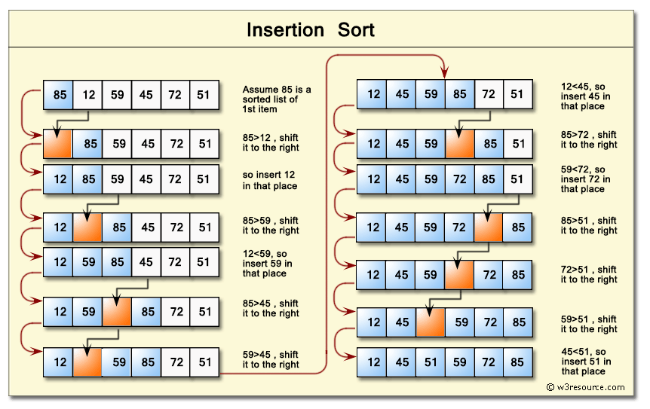
contd..

Slide 24
contd..
void printArray(int arr[], int n)
{
int i;
for (i = 0; i < n; i++)
printf("%d ", arr[i]);
printf("\n");
}
/* Driver program to test insertion sort */
int main()
{
int arr[] = { 12, 11, 13, 5, 6 };
int n = sizeof(arr) / sizeof(arr[0]);
insertionSort(arr, n);
printArray(arr, n);
return 0;
}

Slide 25
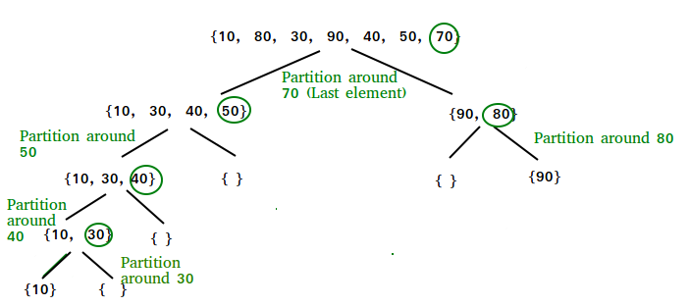
Quick Sort

Slide 26
0 1 2 3 4 5 6
10 80 30 90 40 50 70 (N=7)
Low=0 high=6
Pivot=70 i=0-1=-1
J=0,1,2,3,4,5
Take J=0 a[0]<pivot 10<70 yes i++=0 swap a[i] and a[j]
No change
0 1 2 3 4 5 6
10 80 30 90 40 50 70
Take J=1 a[1]<pivot 80<70 N0
Take j=2 a[2]<pivot 30<70 Yes i++ swap a[1] and a[2]
0 1 2 3 4 5 6
10 30 80 90 40 50 70

Slide 27
0 1 2 3 4 5 6 10 30 80 90 40 50 70
Take j=3 a[3]<pivot 90<70 No
Take j=4 a[4]<pivot 40<70 yes i++ swap a[2] and a[4]
0 1 2 3 4 5 6
10 30 40 90 80 50 70
Take j=5 a[5]<pivot a[5] 50<70 yes i++ swap a[3]and a[5]
0 1 2 3 4 5 6
10 30 40 50 80 90 70
Loop is ended
Swap a[i+1] and a[high]
0 1 2 3 4 5 6
10 30 40 50 70 90 80
Return i+1 =4
Quicksort(a,0,3) and Quicksort(a,5,6)

Slide 28
0 1 2 3
10 30 40 50
Low=0 high=3
i=low-1=-1 pivot=50
J=0,1,2
Take j=0 a[0]<pivot yes 10<50 i++ and swap No change
J=1 a[1]<pivot 30<50 i++ and swap No change
J=2 a[2]<pivot 40<50 i++ and swap No change
Swap a[i+1] and a[high] No change
Return 3
Quicksort(a,0,2) and Quicksort(a,4,3) No call

Slide 29
contd..
* This function takes last element as pivot, places the pivot element at its correct position in sorted array, and places all smaller (smaller than pivot) to left of pivot and all greater elements to right of pivot */
int partition (int arr[], int low, int high)
{
int pivot = arr[high]; // pivot
int i = (low - 1); // Index of smaller element
for (int j = low; j <= high- 1; j++)
{
if (arr[j] < pivot)
{
i++; // increment index of smaller element
swap(&arr[i], &arr[j]);
}
}
swap(&arr[i + 1], &arr[high]);
return (i + 1);
}

Slide 30
contd..
/* The main function that implements QuickSort
arr[] --> Array to be sorted,
low --> Starting index,
high --> Ending index */
void quickSort(int arr[], int low, int high)
{
if (low < high)
{
/* pi is partitioning index, arr[p] is now at right place */
int pi = partition(arr, low, high);
// Separately sort elements before
// partition and after partition
quickSort(arr, low, pi - 1);
quickSort(arr, pi + 1, high);
}
}

Slide 31
contd..
void printArray(int arr[], int size)
{
int i;
for (i=0; i < size; i++)
printf("%d ", arr[i]);
printf("n");
}
int main()
{
int arr[] = {10, 7, 8, 9, 1, 5};
int n = sizeof(arr)/sizeof(arr[0]);
quickSort(arr, 0, n-1);
printf("Sorted array: n");
printArray(arr, n);
return 0; }

Slide 32
Practice Questions
What is the complexity of Quicksort Algorithm? Apply the Quick Sort on the following Array elements:
23 45 12 4 67 50 26
2. What is the complexity of Selection Sort Algorithm? Apply the Selection Sort on the following Array elements:
2 45 122 47 69 55 46
3. What is the complexity of Insertion Sort Algorithm? Apply the Insertion Sort on the following Array elements:
12 45 162 47 59 65 56

Slide 33
4. Insert the following keys: 67, 48, 69, 55, 36, 73, 79, 76 into a hash table of size m=12 using linear probing. Given primary hash function is h(k)= k mod m.

